Slide 1
CM Géoéco
LEA1 – UJML3 – 2020-2021
M. bourdeau

Slide 2
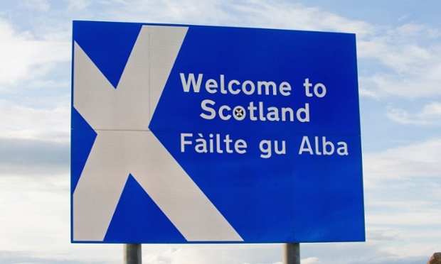
Part 5: Scotland: towards a new Auld Alliance?
M. Bourdeau UJML3 2020-2021

Slide 3
Contents
1. Scotland: the Most European Nation in the UK?
2. Economic Overview
3. The Long Road to the Referendum
4. Brexit: the Game-Changer?
M. Bourdeau UJML3 2020-2021

Slide 4
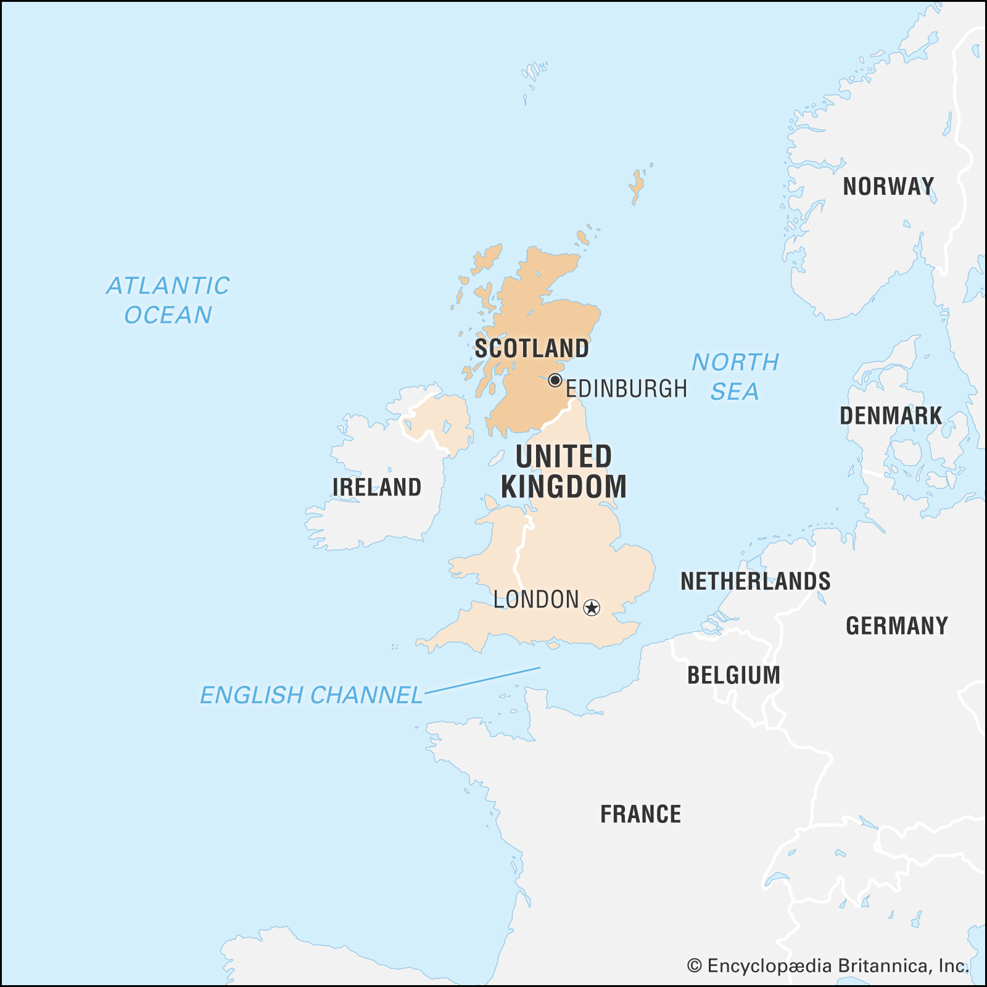

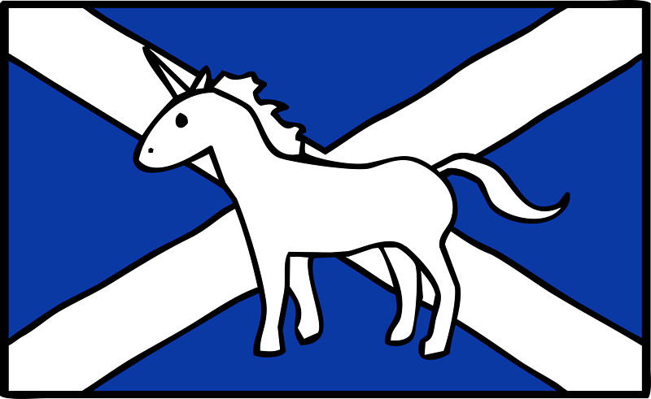
Basic facts about Scotland
Historical name: Alba
Capital: Edinburgh
Population: 5.3 million (2015)
Symbols:
The thistle
The unicorn
M. Bourdeau UJML3 2020-2021

Slide 5
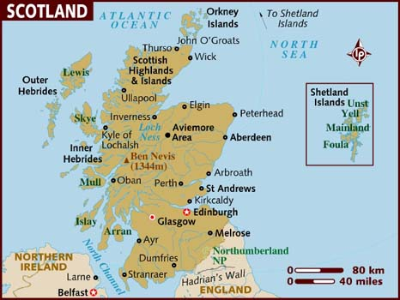
M. Bourdeau UJML3 2020-2021

Slide 6
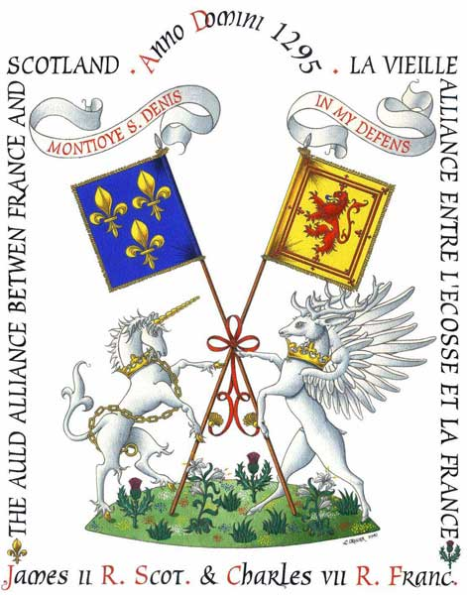
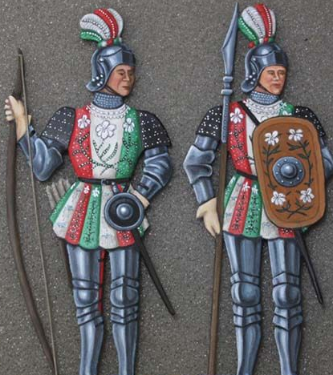
1. European Scotland
France & Scotland: the ‘Auld Alliance’:
1295
Mutual support against England
Diplomatic & military alliance during the Hundred Years’ War (1337-1453)
1415: Battle of Agincourt (S/F defeat)
1429: Joan of Arc and Orleans => Scottish help
French King’s “Garde Écossaise”
After HYW, many Scots became French residents
Long-lasting trade agreements (ex: privileged trade agreements for Scottish sellers of French/Bordeaux wine)
Long-established friendship
M. Bourdeau UJML3 2020-2021

Slide 7
The (long) end of the Auld Alliance:
Reformation:
divided 16th century Europe
Scotland became Protestant vs. France remained Catholic
= unofficial end of the Auld Alliance
1707: Union of Parliaments with England => deeper schism
1906: Official end of the Auld Alliance
Until then, French citizens automatically had dual nationality with Scotland and vice versa
M. Bourdeau UJML3 2020-2021

Slide 8
Other European ties for Scotland:
Scotland and Germany:
trade (Hanseatic League)
religion (Protestant religion imported from Germany => deep influence over Scottish mindset/identity
Proximity with Scandinavia
long history of Viking and Norse settlement in Scotland + linguistic & cultural ties
Gaelic connection with Ireland
=> Scotland as much shaped by its relationships with continental Europe as by its close ties with England / the rest of the UK
M. Bourdeau UJML3 2020-2021

Slide 9
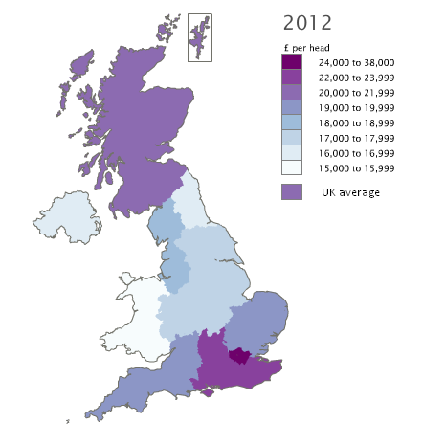
2. Economic overview
GDP :
higher than in all other areas of the UK outside London and England’s South
Second best in the UK after England (3rd: NI; 4th: Wales)
Unemployment:
Consistently lower than the UK average
Decreasing rate (2017: 4% => 2019: 3.2%)
M. Bourdeau UJML3 2020-2021

Slide 10
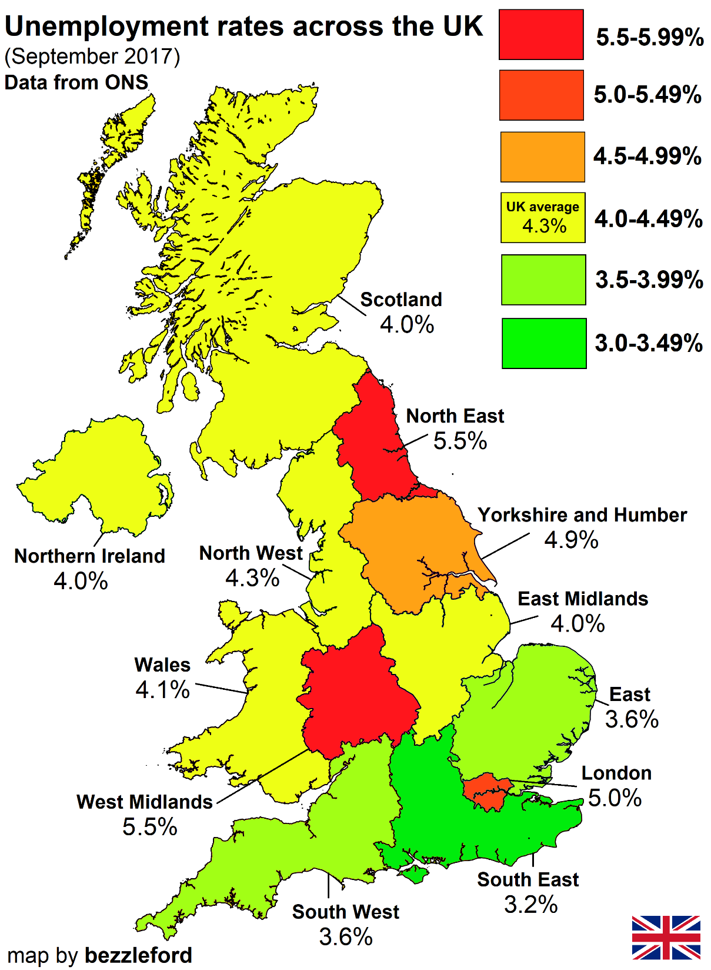
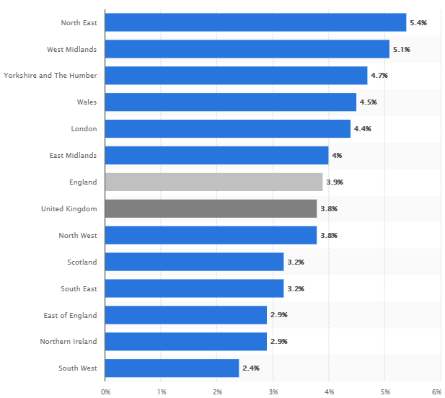
2019
M. Bourdeau UJML3 2020-2021

Slide 11
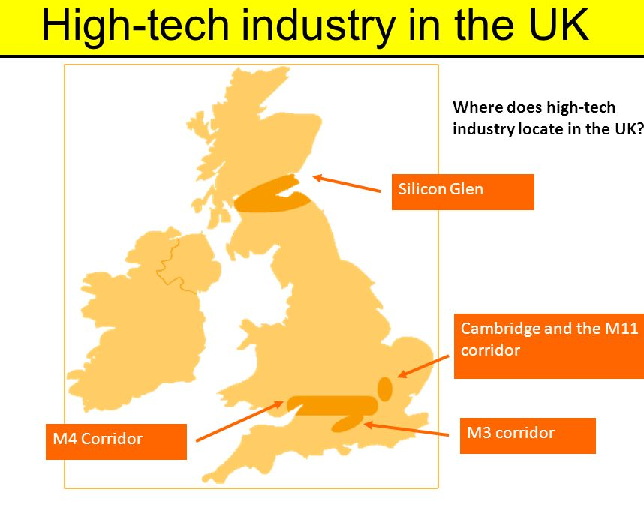
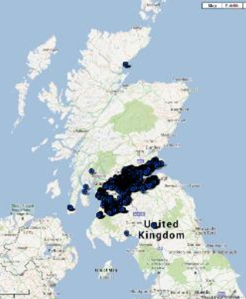
Scottish Industry
Similar development to England/Wales
Industrial revolution => heavy industries (coal, steel, ship construction); peak in 1913.
Then decline (foreign competition, transition to oil) => 2002: last coal mine closed => unemployment
Then gradually diversified and modernised
Heavy industry: new sectors
High technology + consumer goods (electronics, office supplies)
major source of economic growth, employment & export earnings
“Silicon Glen” (Midland Valley)
M. Bourdeau UJML3 2020-2021

Slide 12
Scottish service sectors
Financial and business services
1960s onwards: significant growth
Edinburgh: 2nd biggest British financial centre after London
Tourism: a sector with vital importance
14.6 million visitors (mostly Scottish & English people but also Americans & Europeans)
8.9 billion pounds
Spending by tourists = £12 billion of economic activity / 5% of the total Scottish GDP
196,000 jobs in 2014 (7.7% of employment)
M. Bourdeau UJML3 2020-2021

Slide 13
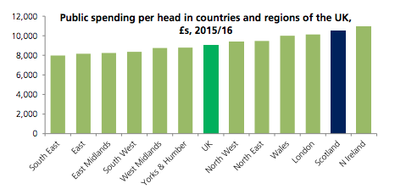
Public sector
Public services
2016: 21% of the workforce
£71.2 billion in 2016/17
Represent 1/5 of GDP
(private services = 2/5 of GDP)
High public spending:
The public sector is larger in Scotland (ex: public water industry)
Some areas: high level of demand (ex academic cities with lots of students)
M. Bourdeau UJML3 2020-2021

Slide 14
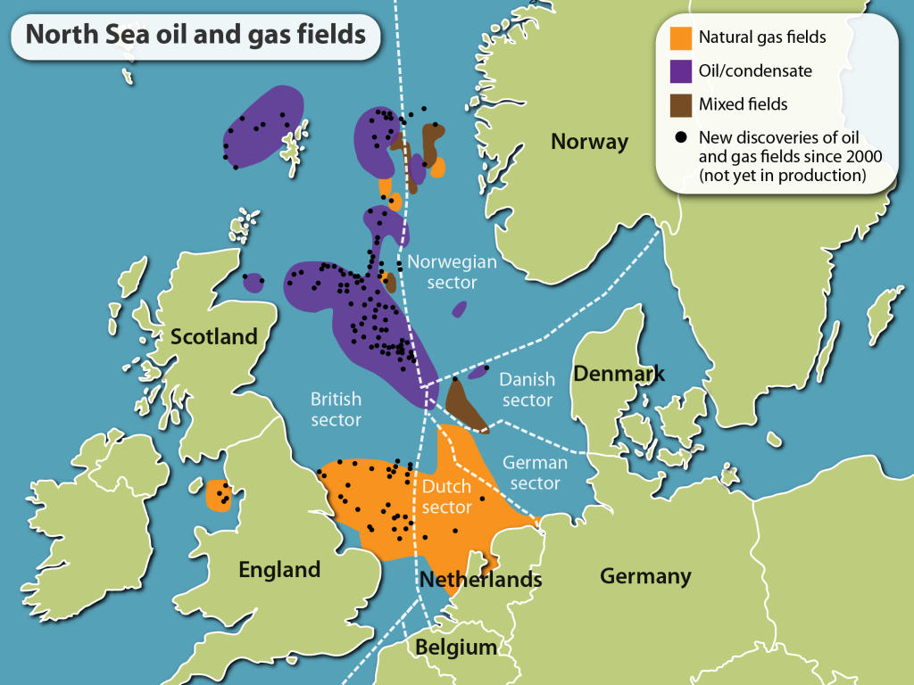
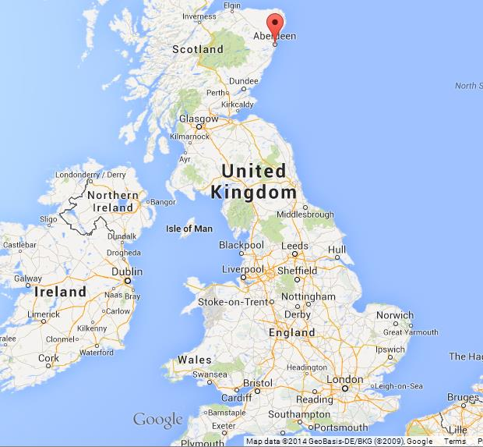
The petroleum industry
Started in the 1970s (North Sea)
On/offshore oil & gas-related industry => 10s of thousands of jobs
Aberdeen (‘the oil capital of Europe’)
Shetland islands (2017 discovery)
Fluctuating international markets but still a prosperous and profitable sector
Still, future challenges (shift to cleaner energy + what happens once oil deposits run dry?
Controvesy: oil fields = Scottish waters BUT owned by the British government.
M. Bourdeau UJML3 2020-2021

Slide 15
3. The Long Road to the Referendum
12th-13th centuries:
Since 9th century (Kenneth I): most of Scotland under the control of a single ruler: nation-state with a feudal system
Still some Gaelic clans
Nation united by the Gaelic language + an emerging Scottish national consciousness
Several English invasions in Scotland to prevent Scottish expansion into Northern England
Demands from English Crown for Scotland to surrender but Scottish rulers refused
Auld Alliance (1295) seen by the English as a declaration of war
England invaded Scotland (1296)
“First War of Scottish independence” (William ‘Braveheart’ Wallace) 1296-1328 => Scottish victory
M. Bourdeau UJML3 2020-2021

Slide 16

14-16th centuries :
The Scottish Stewart/Stuart dynasty imposed its rule over Scotland => period of prosperity
Still clashes on the Scottish/English border but truces (ex: 1502 ‘Treaty of Perpetual Peace’)
17th century:
1603: James VI, King of Scots inherited the Kingdoms of England and Ireland (=> James I: “Jacobean era”)
Union of Crowns
Parliaments of Scotland and England remained separate => tensions between the two
Glorious Revolution (1688): James VII/James II overthrown for being a Catholic & replaced by Mary and William of Orange= end of Stuart dynasty
Famines and economic hardships in Scotland
M. Bourdeau UJML3 2020-2021

Slide 17
18th century:
1707: Union of Parliaments
Presented as a “win-win situation”
Economic security for Scotland
Manpower and resources for England
Still, many riots and protests in Scotland
Jacobite (= pro-James/pro Catholic) risings (1719, 1745): failures
End of Scottish armed rebellion
heavy restrictions on the Scots, ending hopes of independence for the next two centuries
19th century/early 20th:
Political campaigns for Scottish self-government (demands for home rule within the United Kingdom)
M. Bourdeau UJML3 2020-2021

Slide 18
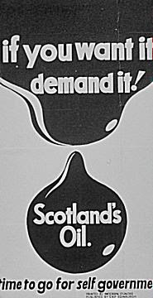
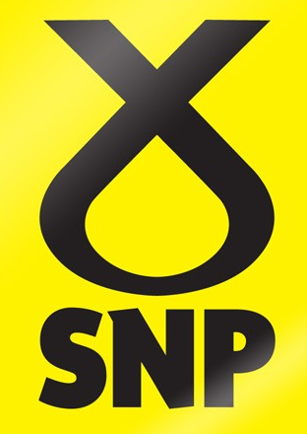
Scottish National Party (SNP)
Creation: 1934
Demands: first a devolved Scottish Assembly, then full independence
Social democratic party (left/centre-left + pro-European)
2nd half of 20th century: gathered momentum
Oil in the North Sea in the 1970s claimed by the British => strong disapproval in Scotland (SNP campaign: “It’s Scotland’s oil!”)
1974 = 30 percent of the Scottish vote => 11 seats in Westminster
Thatcherism
M. Bourdeau UJML3 2020-2021
Notes:
SNP logo = a stylized combination of the “Saltire”, the diagonal cross on the Scottish flag, and a thistle, the national flower of Scotland.

Slide 19

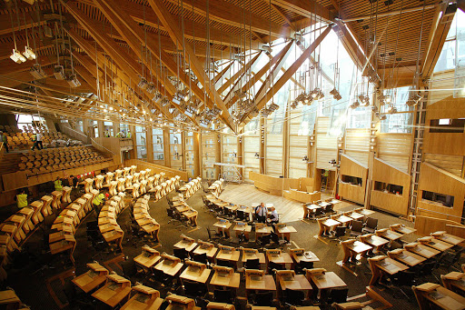
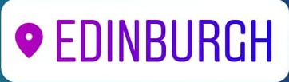
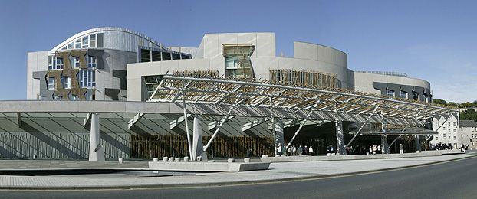
Scottish Devolution
1997 = referendum on devolution
1998 = Scotland Act (=> creation of devolved SP)
1999 = Scottish parliament re-established: first session on May 12th
Scottish Parliament /Pàrlamaid na h-Alba / Scots Pairlament
‘Holyrood’
M. Bourdeau UJML3 2020-2021

Slide 20
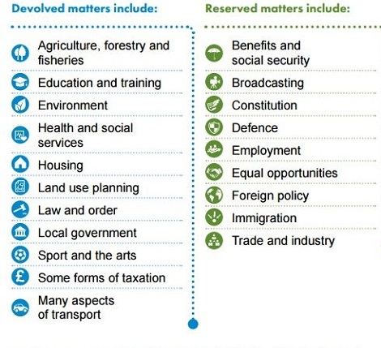
Scottish Devolution
Unicameral legislature
129 members: MSPs (Members of the Scottish Parliament)
Elections every 4 years
Full legislative power ever since 1999 (primary legislation)
Devolved & reserved matters
M. Bourdeau UJML3 2020-2021

Slide 21
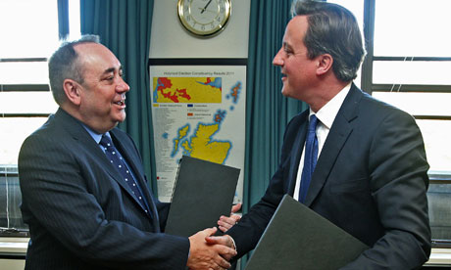
Scottish Devolution: not enough?
2007: SNP = first majority in the Scottish
Parliament; majority party ever since.
Growing pressure for referendum
Alex Salmond (SNP)
First Minister (2007-2014)
2012: had David Cameron agree to a referendum on independence for Scotland (=> Scottish Independence Referendum Act 2013)
M. Bourdeau UJML3 2020-2021

Slide 22
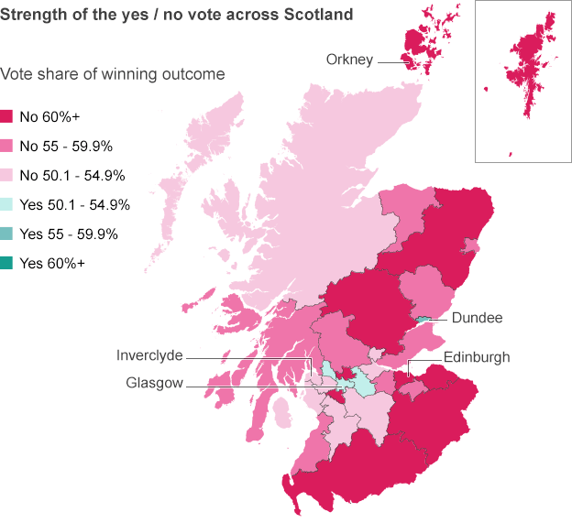
September 18th 2014 referendum
Referendum terms
Age to vote: lowered to 16
Wording: “Should Scotland be an independent country?”
Campaign: “Yes Scotland” vs. “Better Together”
Turnout: 84.6% (historic number)
Result: 55.3% NO vs. 44.7% YES
Major reasons behind votes:
In favour of NO = “retention of the pound sterling” + threat of end of EU membership (!)
In favour of YES = "disaffection with Westminster politics“
‘Once in a generation vote’ => consensus that no other referendum before long
M. Bourdeau UJML3 2020-2021

Slide 23
Still, overall positive outcome for Scotland’s autonomy:
Polls before the ref => British gov afraid => offered greater autonomy:
Scotland Act 2012; gave the Scottish Parliament
right to raise or lower income tax more freely
limited (but extra) powers regarding drugs, driving, and guns, etc.
+ guaranteed Scottish representation in/on the BBC
Further autonomy even after the referendum:
Scotland Act 2016: gave the Scottish Parliament
more tax-raising powers
widely increased fiscal autonomy
more control over public expenditure
more control over welfare rates
=> Problem solved?
M. Bourdeau UJML3 2020-2021

Slide 24
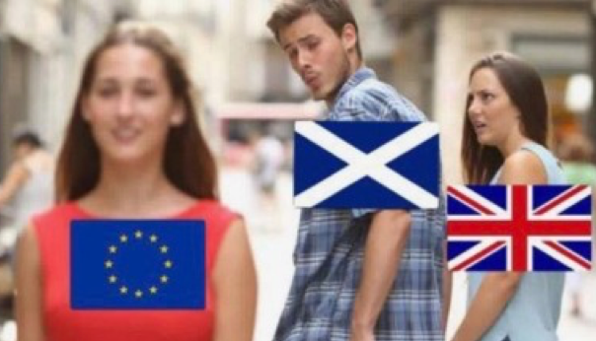
4. Brexit: the game-changer?
Reminder:
before Brexit, main argument against Scottish independence /main reason for the NO vote in 2014 =
threat that independent Scotland = no UK but also no EU membership
(Scotland could have applied for EU membership but the UK could have refused it)
Would have left Scotland in position of acute isolation
M. Bourdeau UJML3 2020-2021

Slide 25
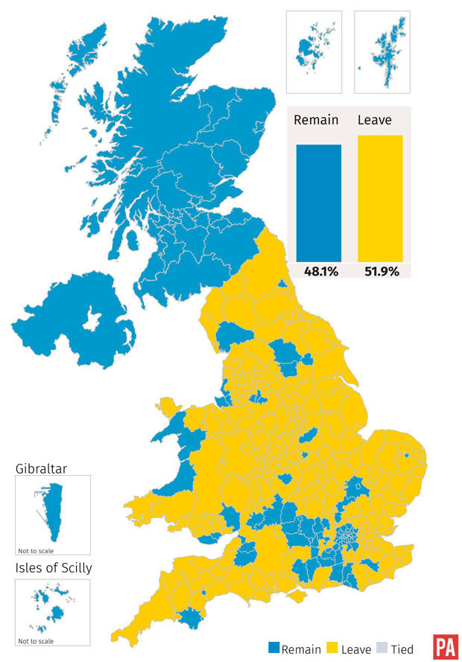
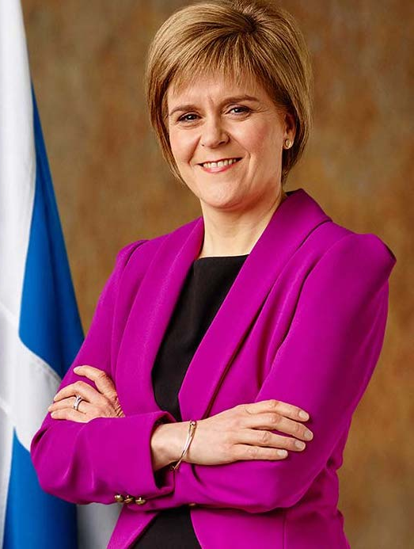
Brexit
Scottish vote = Remain (62%)
Brexit => changed circumstances => new talks about independence
Nicola Sturgeon (First Minister, SNP):
=> need for a new debate on independence
SNP’s responsibility to lead this debate
“My message to the prime minister is this: you may have a mandate in England and Wales to leave the EU but you do not have a clear mandate to take any part of the UK out of the single market.”
Ironic reversal: independent Scotland= formerly presented as a dangerous prospect (meant it could not stay in the EU) => now the only hope for Scotland to become part of the EU again.
M. Bourdeau UJML3 2020-2021

Slide 26
Towards a second referendum?
March 28th 2017: Scottish Parliament approved SNP’s plans to ask for a new referendum
BUT reserved matter => need for British gov’s consent and initiative
Formal request sent to British Parliament soonafter
Theresa May’s answer: “Now is not the time”
2019 UK elections: SNP won 48 out of 59 possible seats in Westminster (+13 seats) => reinforced power and legitimacy
New request to B. Johnson in Dec 2019 => refused in Jan 2020 because:
2014: Sturgeon’s “a once-in-a-generation vote” promise
BJ: “The UK government will continue to uphold the [2014] democratic decision of the Scottish people and the promise you made to them.”
Ever since, BJ has been trying to undermine support for SI by promising big funding for infrastructure in Scotland
M. Bourdeau UJML3 2020-2021

Slide 27
Scottish independence: what main consequences?
From the UK’s perspective:
British naval bases in Scotland (nuclear submarines): Scottish Independence => weakening of the British defense?
Oil (cf Moodle)
Most importantly (?) symbolical blow: DisUnited Kingdom
From the EU’s perspective:
Administratively speaking: completely possible: existing legal framework ensuring smooth transition (between referendum & actual independence) towards independent membership (ex Lisbon Treaty, Article 48)
EU’s self interest? = accepting Scotland’s application
Scotland’s membership in the single market would be a plus
Scotland’s more than willing to be part of the EU (cf 2014 NO vote, Brexit vote, subsequent moves to maintain links with the EU ex Erasmus programme)
EU’s principle = enlargement, not contraction
M. Bourdeau UJML3 2020-2021

Slide 28
2021: a turning point?
SNP/Sturgeon: reaffirmed political determination, exacerbated by criticism faced by BJ in Scotland regarding his (mis)management of the Covid-19 crisis
Crucial May 2021 elections in Scotland. Recent Ipsos poll:
52% are likely to vote for the SNP (Scottish Conservatives = 23%; Scottish Labour 15%)
52% would vote Yes in an independence referendum, (Nov 2020: 56%)
Independence is seen as the top issue helping people decide which party to vote for (44%)
If SNP wins the 2021 elections, Sturgeon:
will hold an advisory referendum on independence (with or without Westminster’s consent)
will request from the UK gov a Scotland Act 1998 section 30 order (allows Holyrood to pass laws normally reserved to Westminster)
2021 four-nation polling (Sunday Times): a majority of voters in Scotland and Northern Ireland want referendums on the breakup of Britain=> major change on the horizon?
M. Bourdeau UJML3 2020-2021

